Slide 1
Text matching and classification in Arabic Finding use of Quran Verses in Jihadi Texts
Maulik Shah

Slide 2
Summary
Identify the use of Quran verses used by Jihadis in their texts.
Analyze pattern in use of Quran verses.
Create a predictive model for finding a violent text with respect to Quran verses.
Extension to the research of Dr. Jason, which finds the violence score in Quran and Bible verses.

Slide 3
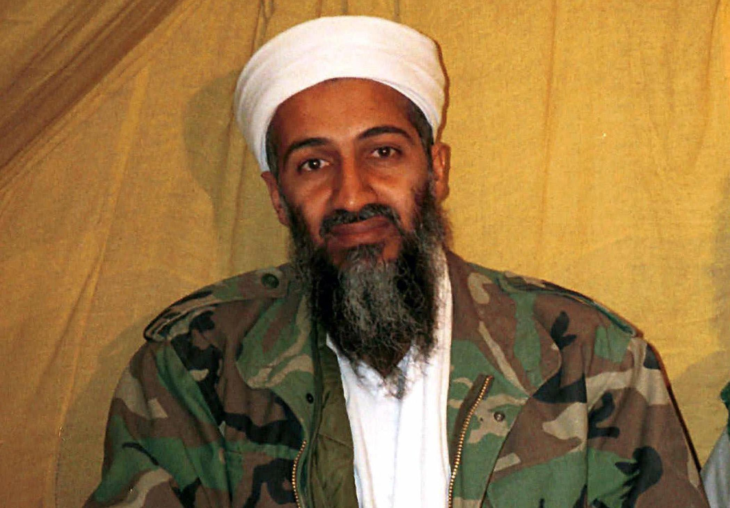
Data Availability
Violence Score available for each of the verse of Quran from the previous research of Dr. Jason.
6 different versions of Quran.
575 paragraphs of text written by :

Slide 4
Data Preparation
Merging of 6 different versions of Quran with the violence score
Creating a formatted CSV of paragraph of 575 documents from 12 different Word files.
A lot of labor !!

Slide 5
Data Filtering and Stemming
Filtering the data for the punctuation, postfix, prefix, numbers
Stemming the paragraphs
Transliterate
API used is “ArabicStemR”

Slide 6
Methods
For Similarity :
Cosine Similarity
LDA Similarity
For Prediction:
Logistic Regression
Naïve Bayes
SVM

Slide 7
Procedure
Data Cleansing and Stemming.
Create Document Term Matrix. Frequency Matrix in case of Naïve Bayes.
For similarity , compare each document with each Quran verse.
For Prediction, 85% - Training and 15% - Testing of Quran Verses.
Apply models and validate.

Slide 8
Results
PLOTLY library in R.
Results are as shown in the Browser.

Slide 9
Conclusion
Cosine Similarity ➔ Good.
LDA Similarity ➔ BAD.
Naïve Bayes ➔ Better than others, but can’t say !
More labeled data is needed for the prediction.

Slide 10
Conclusion
Significant reference from Quran in the documents.
Almost none of the verses used were violent !!!!!
Prediction needs more data to have a better classifier, but you can predict if a document is violent or not effectively.
Arabic data analysis can be possible with current available APIs and machine learning methods work well on them.

Slide 11
Conclusion
Significant reference from Quran in the documents.
Prediction needs more data to have a better classifier, but you can predict if a document is violent or not effectively.
Arabic data analysis can be possible with current available APIs and machine learning methods work well on them.

Slide 12
Future Work
Expert help for identifying the similarities.
Use more documents for finding similarities.
Apply more document classified as ‘violent’.

Slide 13
Thank You. Questions ??

